Slide 1

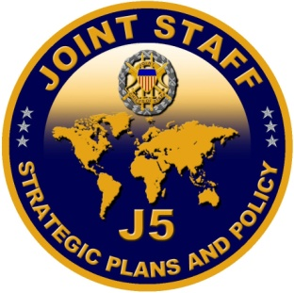
Chairman’s Vision of
Global Integration
    COL Francis J. H. Park, U.S. Army
    Strategy Development Division
    Directorate for Strategy, Plans, and Policy (J-5)
    The Joint Staff
    Overall classification of these slides is
    UNCLASSIFIED
24 May 2018
UNCLASSIFIED

Slide 2
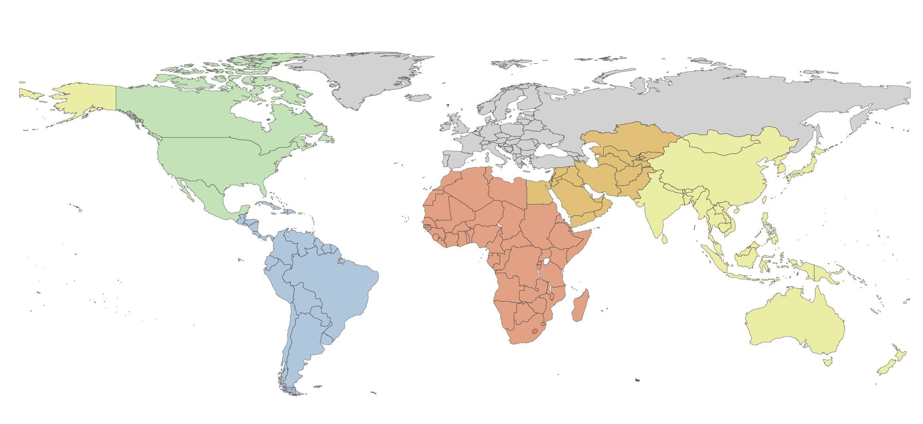











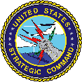



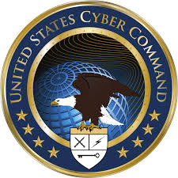
Why Global Integration?
UNCLASSIFIED
Today’s strategic environment has changed:
  Proliferation of advanced technologies have accelerated the speed and complexity of war
  Conflicts involve all domains and cut across multiple geographic regions
  American competitive military advantage has eroded
  Global demand for forces continues to exceed the inventory
USEUCOM
USNORTHCOM
Functional CCMDs
USCENTCOM
USPACOM
USAFRICOM
USSOCOM
USSTRATCOM
USSOUTHCOM
USTRANSCOM
USCYBERCOM

Slide 3

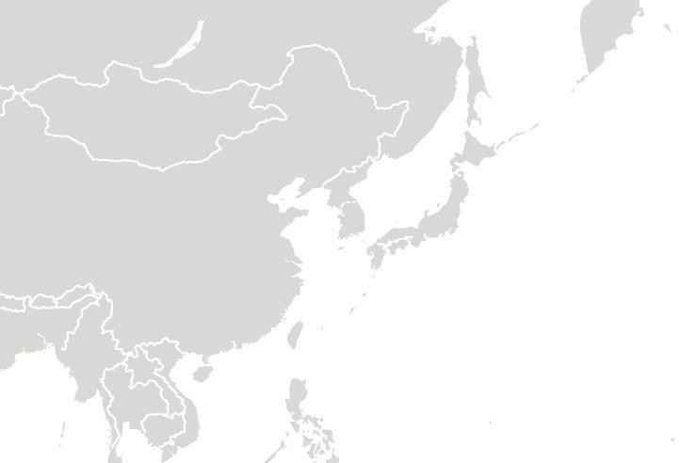
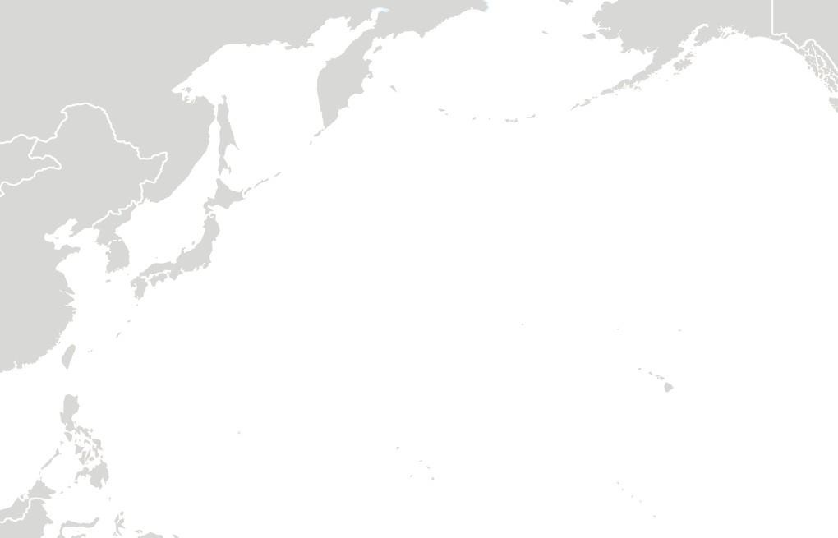













Global Integration Case Study: North Korea
UNCLASSIFIED
1990s:
Today:
“End of History” – No peer competitor
Possessed a competitive advantage over any potential adversary
Joint Force had sufficient resources to address global requirements
Threat from DPRK limited to Korean peninsula, Japan, and USPACOM AOR
Regionally focused planning, OPLANS, and supporting/supported construct was sufficient
Return to Great Power competition
Competitive advantage eroding (caused by budget instability, operational commitments, adversary advancement)
Joint Force lacks sufficient capacity to meet combatant command requirements
DPRK threat is trans-regional, all-domain, multi-functional
Requires a globally integrated, campaign mindset
Global force posture must be flexible, agile, and responsive
ICBM
Counter Space
USNORTHCOM (BMD)
USSTRATCOM
(Space/Nuclear)
Area of Operations (USFK Lead)
Cyber
Ballistic Missiles
USCYBERCOM
Supporting/ Supported
USSTRATCOM USEUCOM USTRANSCOM
Area of Interest and Operations is now global
Area of Interest
(USPACOM Lead)
Legacy planning and decision making constructs are insufficient to deal with the speed of war today

Slide 4



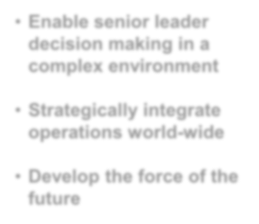



How is global integration achieved?
UNCLASSIFIED
METHODS
END-STATES
Planning: Ensure plans address all-domain, trans-regional challenges and develop strategies to manage risk globally
Senior leaders are able to make decisions at the speed of relevance in a complex environment
Decision Making: Develop shared understanding and routine dialogue to facilitate decision making at speed of war
Operations and resources are aligned with strategic priorities and integrated globally
Force Management: Meet day-to-day requirements while maintaining readiness/flexibility to respond to the unexpected
A lethal, agile Joint Force possesses a competitive advantage over any adversary
Force Development & Design: Integrate concepts and capabilities to deliver a lethal force, capable of competing and winning against any adversary
Assessments: provide the analytic foundation for all we do
“These processes are interdependent and mutually reinforcing – designed to drive the
change required to maintain our competitive advantage.”
– Gen Joseph F. Dunford, CJCS

Slide 5
Global Integration: Planning
UNCLASSIFIED
Intent: Develop a top-down, iterative approach to synchronize activities and resources in time, space, and purpose—across Combatant Commands
  Apply a global perspective to trans-regional problems
  Shift planning from a regional, OPLAN construct to a campaign mindset
  Orient day-to-day activities to support policy objectives that advance national interests
How this is achieved:
  The NDS is the “what,” the NMS is the “how”
  Joint Strategic Campaign Plan (JSCP) provides measurable, intermediate military objectives and guidance for combatant commands
  Global Campaign Plans (GCPs) group all planning and execution efforts for a problem set under a single global construct -- driven and approved by the Secretary of Defense

Slide 6
Global Integration: Decision Making
UNCLASSIFIED
Intent: Develop a process that frames decisions, synthesizes information and intelligence, and enables senior leaders to make decisions at the speed of relevance
How this is achieved:
  A baseline for senior leaders to “See the force”
    Common intelligence and operations picture
    Shared understanding of global force posture
  Test plans and concepts through rigorous exercises and war games
    Test command and control structures
    Identify gaps and seams between combatant commands
    Inform strategic assessments and resource allocation
  Build a routine dialogue to support senior leader decision making
    Enable implicit communication among senior leaders
    Facilitate rapid decision making in times of crisis

Slide 7
Global Integration: Force Management
UNCLASSIFIED
Intent: Optimize the way we posture capabilities globally to meet day-to-day requirements while maintaining the readiness and agility of the Joint Force to respond to the unexpected
How this is achieved:
  Adapt force management processes to align resources to strategic priorities
    “Set the Globe” from strategy to attain NDS and NMS outcomes
    Identify risks, trade-offs, and opportunities
  Implement Dynamic Force Employment (DFE)
    Meet combatant command requirements and build readiness
    Retain the ability to respond to the unexpected
    Be strategically predictable and operationally unpredictable
  Develop innovative solutions
    Visualize complex strategic environment
    Leverage AI to better understand trade-offs and manage risk
    Dynamically “set the globe” to maximize flexibility, agility, responsiveness
    Provide greater decision space to senior leaders

Slide 8
Global Integration: Force Development & Design
UNCLASSIFIED
Intent: Maintain a balanced inventory of capabilities of capacities today and deliver a more lethal, agile Joint Force for the future
How this is achieved:
  Concepts provide a flexible “aim-point” for what the Joint Force must do and the capabilities required in the future
    Joint Operating Environment (JOE) describes the future security environment
    Capstone Concept for Joint Operations (CCJO) provides a futures “common-playbook” for the Joint Force
  Strategic assessments benchmark Joint Force’s ability to meet today’s strategy and adapt for future requirements
    Joint Military Net Assessment compares our trajectory compared to adversaries
    Analytic baseline for materiel and non-materiel requirements
    Assess capabilities to identify gaps and solutions and improve competitive advantage
  Ensure technological and operational superiority today and tomorrow
    Adapt capabilities to ensure our competitive advantage today
    Innovate through technology & asymmetric solutions for tomorrow
    Advice for investment and divestment efforts for solutions across DOTMLPF-P
UNCLASSIFIED

Slide 9
Re-invigorated Strategic Assessments
UNCLASSIFIED
Strategic assessments underpin Global Integration efforts through the analytic rigor to inform both our ability to meet the current strategy and develop a future force that maintains our competitive advantage.
How this is achieved:
  The Chairman’s Risk Assessment (CRA):
    Cornerstone of the assessment process
    Evaluates the Joint Force’s ability to execute the current strategy
    Provides a global perspective of risk across the entire Joint Force
  The Joint Military Net Assessment (JMNA):
    Benchmarks capability/capacity against pacing threats today
    Compares our trajectory vis-à-vis adversaries
    Provides analytic baseline for future requirements, identifies areas for innovation
  Integrate assessments and exercises:
    Simulates all aspects of warfighting, from the tactical to the strategic
    Tests potential materiel and non-materiel solutions
    Advances interoperability with allies and partners
UNCLASSIFIED

Slide 10
Conclusion
UNCLASSIFIED
Over the past two years, the Joint Force has made tremendous progress in each of these areas, but more work is required:
  Global Integration is not an end unto itself.
  To ensure the Joint Force’s competitive advantage today, and tomorrow, we must:
    Enable Senior leaders to make decisions at the speed of relevance
    Strategically integrate operations world-wide
    Develop a future force capable of competing and winning against any potential adversary
  There is no pre-ordained right to victory on the battlefield.
  Today, the U.S. faces a more complex and dynamic security environment than ever before.
    To keep pace with the changing character of war, we must adapt and innovate – if we fail to keep pace, the Joint Force will lose the ability to compete… and win.
UNCLASSIFIED

Slide 11
Questions?
UNCLASSIFIED
COL Francis J.H. Park, U.S. Army
Chief, Strategy Development Division [Pentagon 2E765]
Deputy Directorate for Joint Strategic Planning, Joint Staff J-5
NIPRNET: francis.j.park.mil@mail.mil
SIPRNET: francis.j.park.mil@mail.smil.mil
JWICS: francis.j.park@coe.ic.gov
Commercial: 703-697-6126/DSN 312-227-6126/VoSIP 302-221-0566
UNCLASSIFIED

